Slide 1

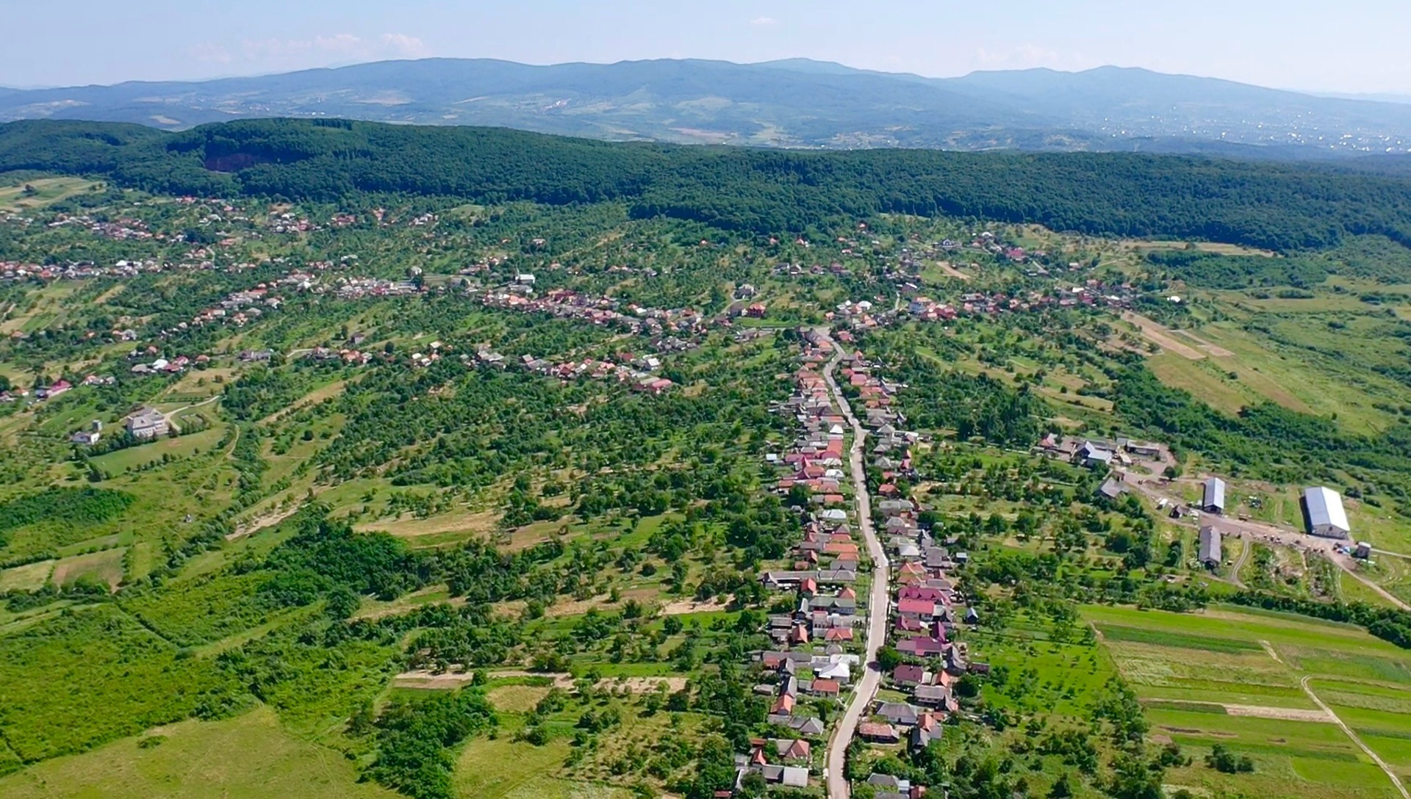



Transcarpathian region, Ukraine, 2026
Kamianska territorial community
A united, progressive, and innovative
community in the central lowland and foothill region of Transcarpathia

Slide 2

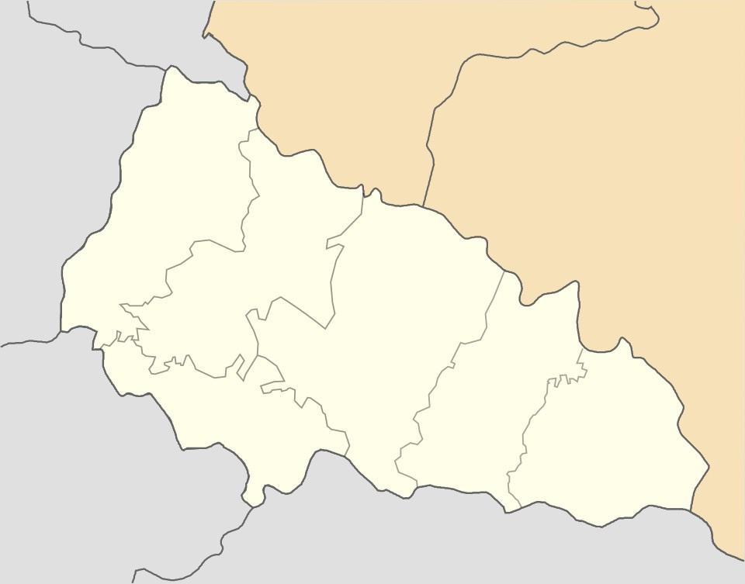




General information
and geolocation
Kamianska community
Transcarpathian region, Ukraine
Poland
  The Kamianska Territorial Community is located in the Berehove District of Transcarpathian region; the area lies in a lowland zone, which ensures a warm climate.
  The national highway H-09 (Mukachevo-Rakhiv-Borodchany-Ivano-Frankivsk-Rohatyn-Bibrka-Lviv) runs through the administrative center, the village of Kamianske.
  The community’s territory is also crossed by state-level public roads: Kamianske–Berehove and Irshava–Vynogradiv (through the village of Siltse in our community).
  The distance to the district center, Berehove, is 27 km; the distance to the regional center, Uzhhorod, is 71.3 km.
  The distance to the nearest border with the EU – the border with Hungary (the “Luzhanka” checkpoint) – is 35 km.
  The community has a population of 9,447, which represents significant labor and social potential for economic development. The administrative center of the community – the village of Kam’yanske – has 1,455 residents, including approximately 500 people of Roma ethnicity.
Lviv region
Slovakia
Ivano-Frankivsk region
Uzhhorod
district
Mukachevo
district
Khust district
Kamianske
Tyachiv
district
Beregove
district
  8
Hungary
Rakhiv district
settlements
Romania
  9447
residents
  71.58 square kilometers
community square

Slide 3
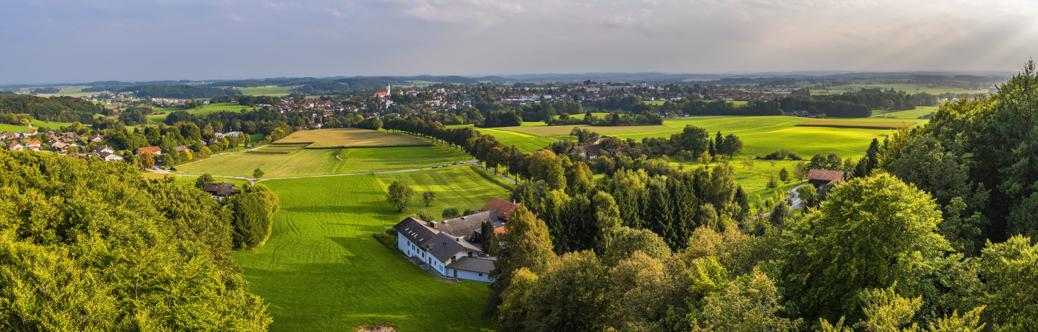
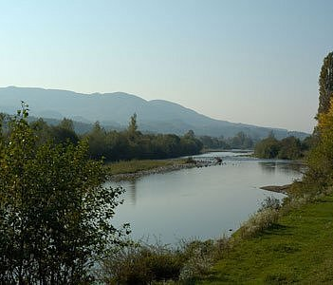
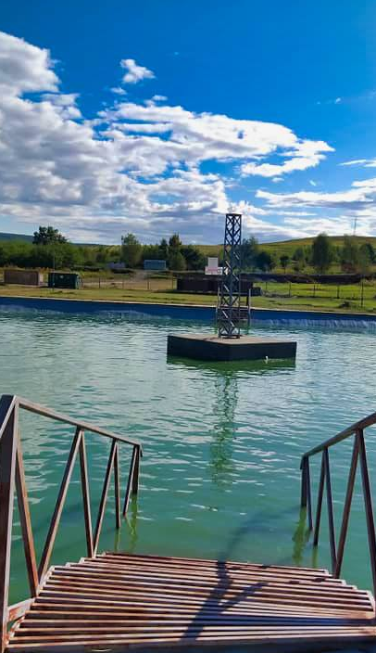

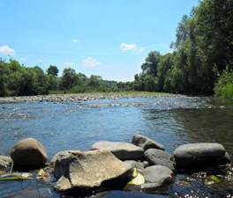
Kamianska community
Transcarpathian region, Ukraine
Main advantages of the location
Natural resources
  The area contains deposits of minerals — andesite, basalt, and refractory clays. Specifically, the village of Ardanovo has an andesite deposit suitable for the production of high-strength crushed stone and rubble stone, while the village of Siltsi has an andesite-basalt deposit. In the village of Midyanytsia, there is a deposit of high-quality refractory clays suitable for porcelain and earthenware production and export.
  The Irshavka and Borzhava Rivers — tributaries of the Tisa — flow through the community’s territory, and there are also artificial reservoirs and ponds. The total area of the community’s water resources is 155,46 hectares, which creates opportunities for recreation, fish farming, and tourism development.

Slide 4
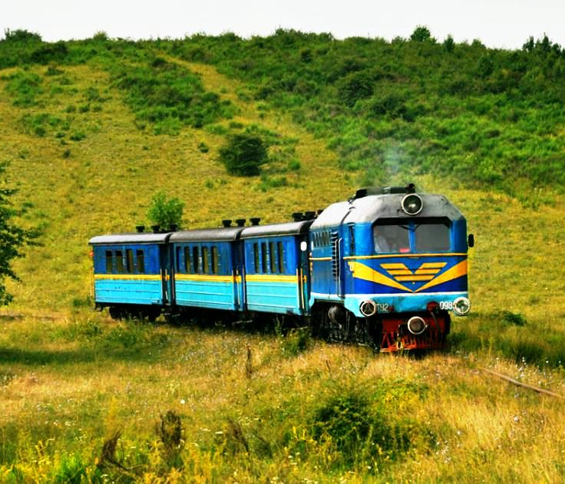
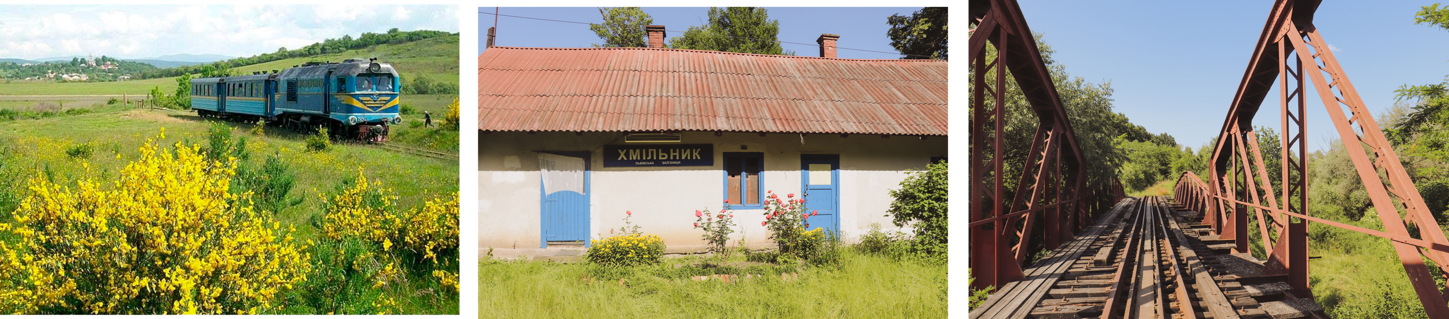

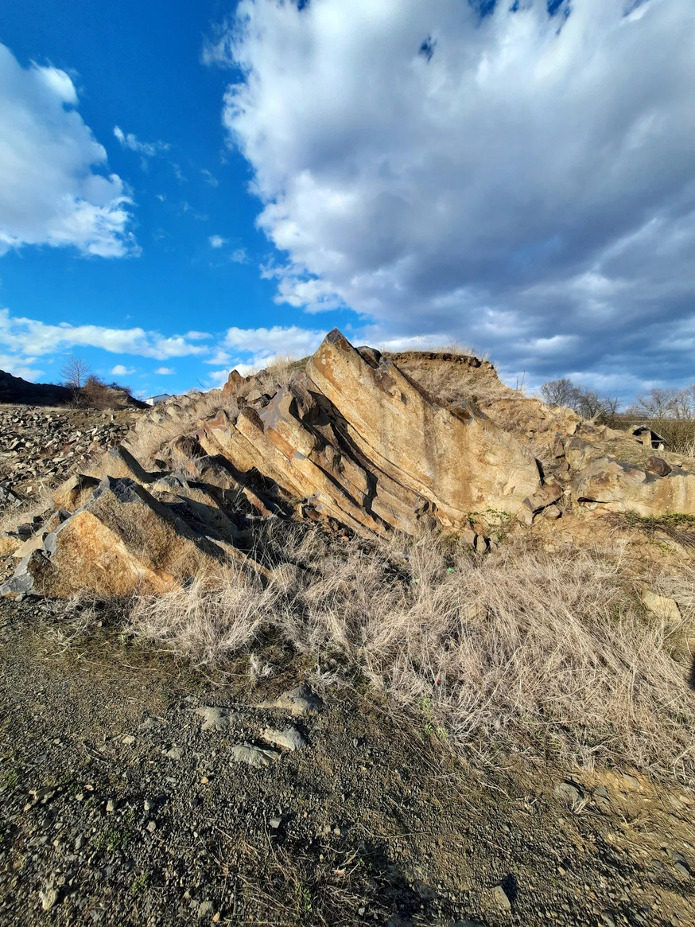
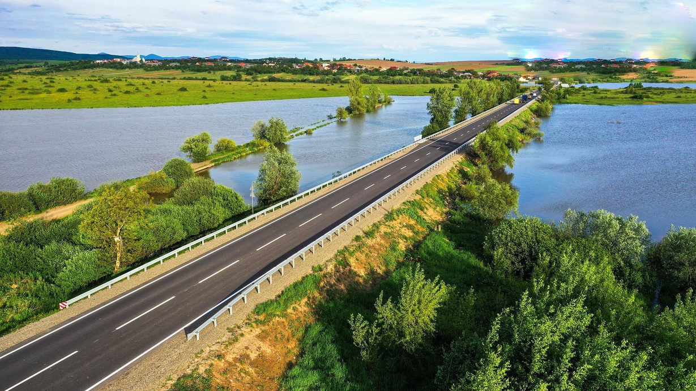

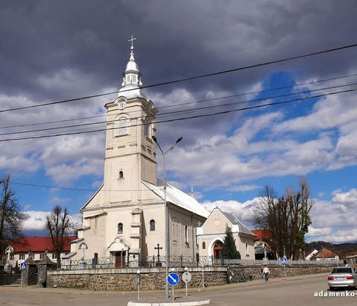
Kamianska community
Transcarpathian region, Ukraine
Main advantages of the location
Logistics and Location
  The community has convenient transportation links to the cities of Berehove, Mukachevo, and Uzhhorod. This transportation accessibility and proximity to the regional center create opportunities for the development of industrial parks and logistics centers, significantly contributing to the revitalization of economic and commercial activity in the community.
  Proximity to the state border with Hungary creates additional opportunities for cross-border cooperation, the development of trade, logistics, and investment projects.
Unique transportation features
  The narrow-gauge railway in the village of Khmilnyk in our community is part of the historic Borzhava Narrow-Gauge Railway, also known as the “Ancia Kushnytska,” which currently operates on a limited basis. The Khmilnyk station is considered a junction station and is a key component of this railway.

Slide 5
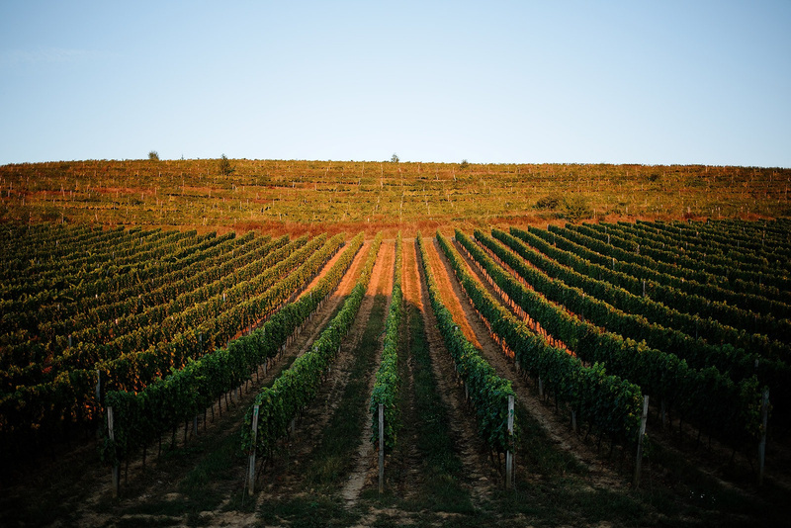
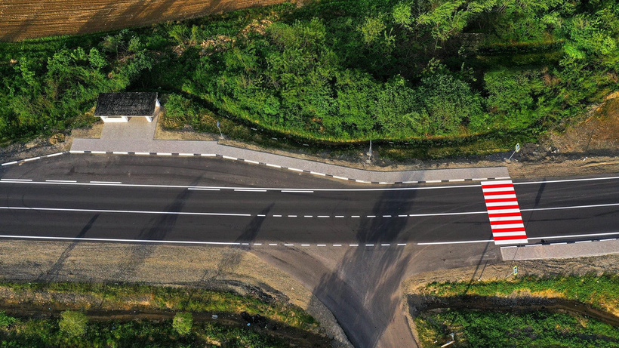
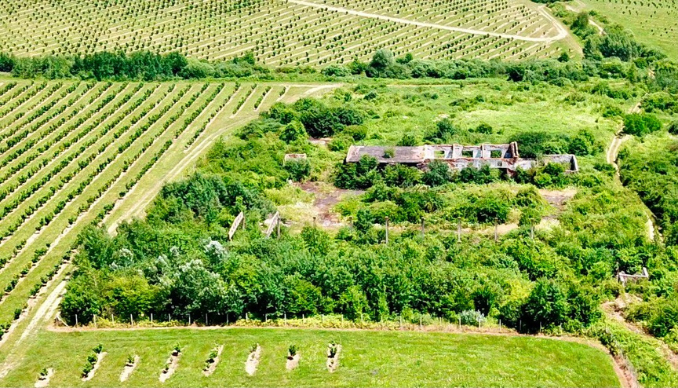
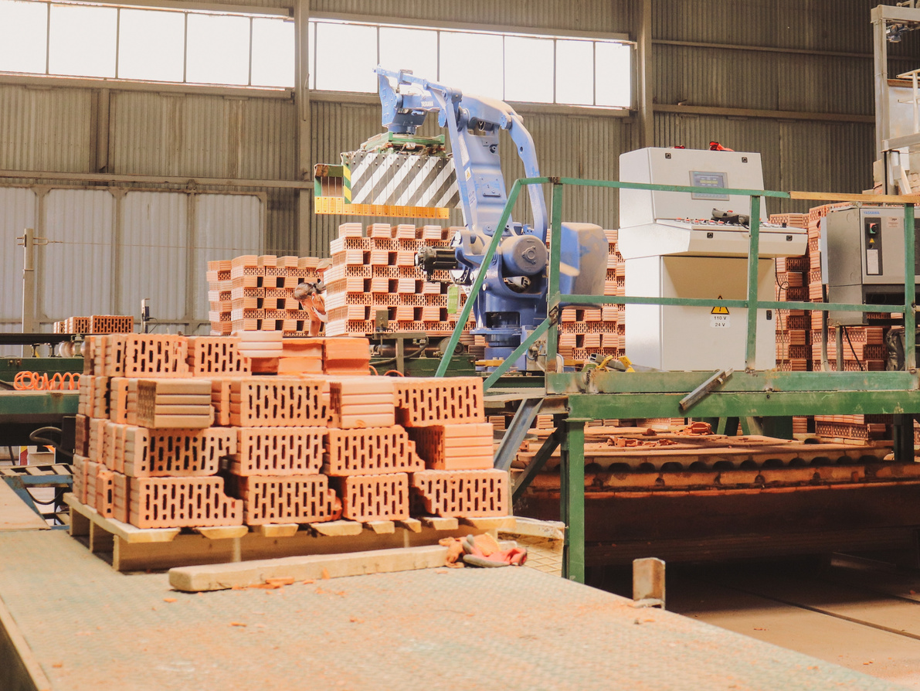
Community strengths
Kamianska community
Transcarpathian region, Ukraine
A strategic geographical location and excellent transportation links via the H-09 Mukachevo–Khust–Rakhiv–Rohatyn national highway, as well as proximity to state borders and border crossing points
The availability of a significant amount of municipally owned land for attracting investment, agricultural production, and the establishment of municipal power generation facilities and business relocation
The presence of mineral resources of local significance for the construction industry

Slide 6

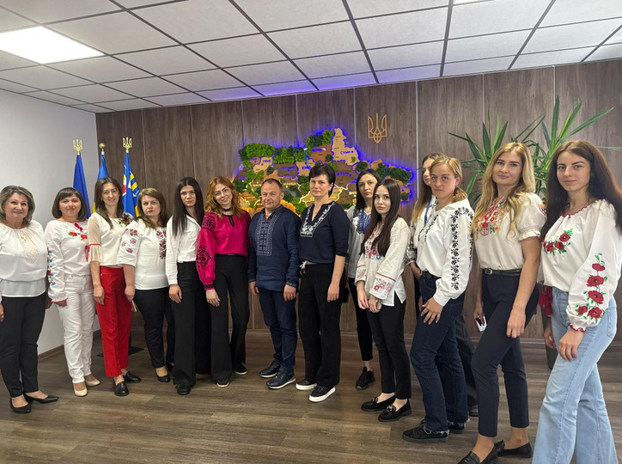
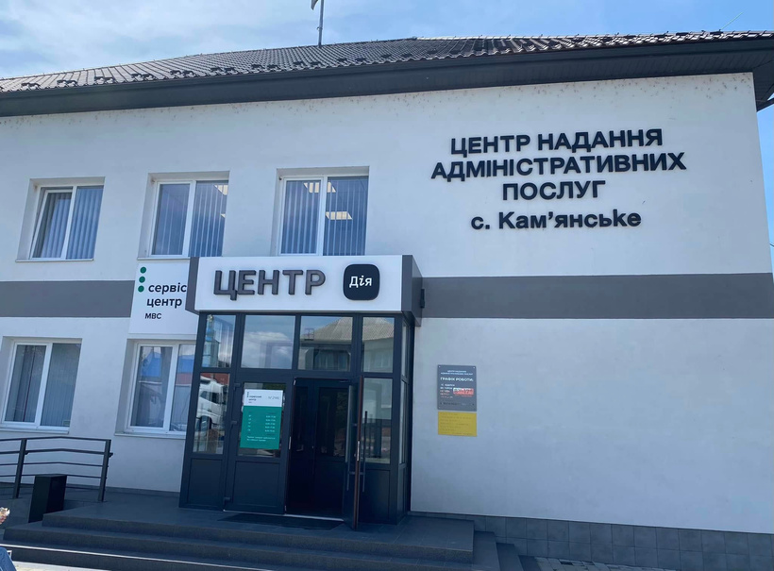
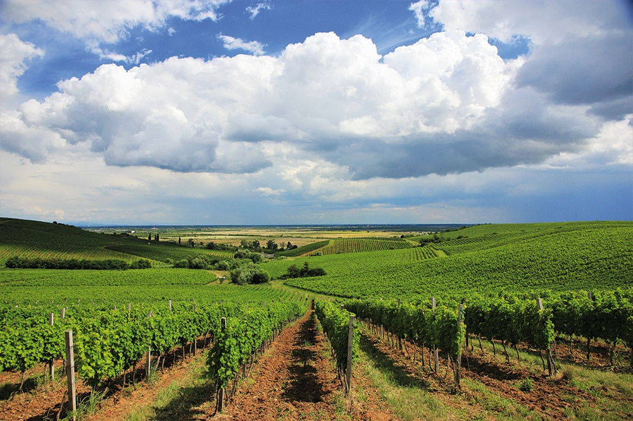
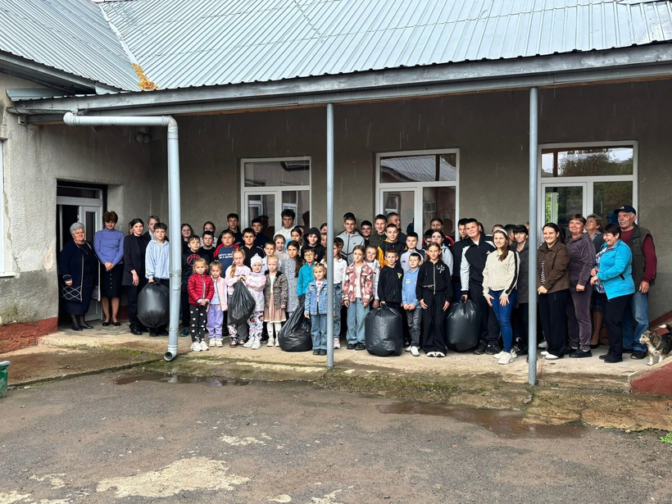
Community strengths
Kamianska community
Transcarpathian region, Ukraine
A properly functioning Administrative Services Center (ASC)
A qualified and proactive team of managers from the village council and its executive bodies
Entrepreneurial, active, and creative community members
Experience in the effective use of land resources for agricultural production and the recreation and wellness sector, and in attracting investment

Slide 7





The main branches of the economy
Kamianska community
Transcarpathian region, Ukraine
1. Agriculture
Cereal cultivation (winter wheat, spring and winter barley, corn, millet); vegetable farming (tomatoes, cucumbers, cabbage); grape growing; hazelnut cultivation.
2. Brick manufacturing
The community’s territory contains deposits of andesite, basalt, and refractory clays (in the villages of Ardanovo, Silce, and Midyanitsa), which offers potential for the development of quarries for the extraction of construction raw materials and the production of building materials
3. Logistics
Some residents of the community are involved in freight and passenger transportation, which fosters economic ties with other communities and regions
4. Trading and small business
The community is home to a number of small retail establishments, family-run businesses, and sole proprietorships that provide goods and services to residents and form the backbone of the local economy.
5. Service area
Includes restaurants, personal services, repair services, transportation, and other services for the public

Slide 8
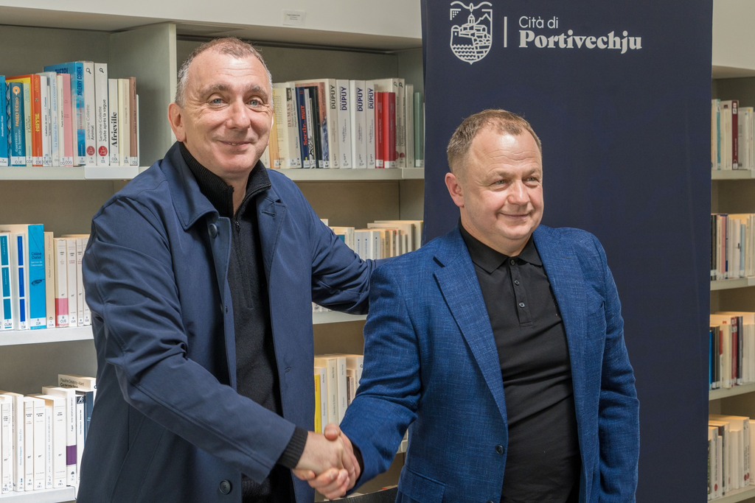
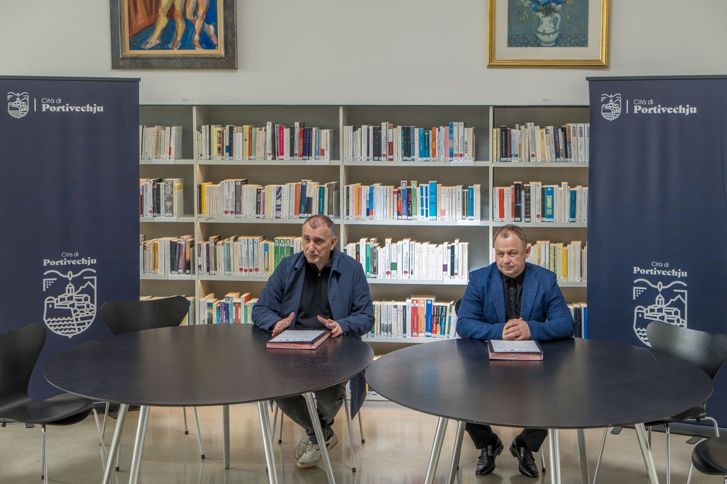
Partnerships with
communities in Europe
Kamianska community
Transcarpathian region, Ukraine
In March 2024, Mykhailo Staninets, head of the Kamianska community, signed an international partnership agreement with Jean-Christophe Angelini, mayor of Porto-Vecchio (Corsica, France). The agreement was the result of the “Bridges of Trust” initiative under the “U-LEAD with Europe” program.

Slide 9


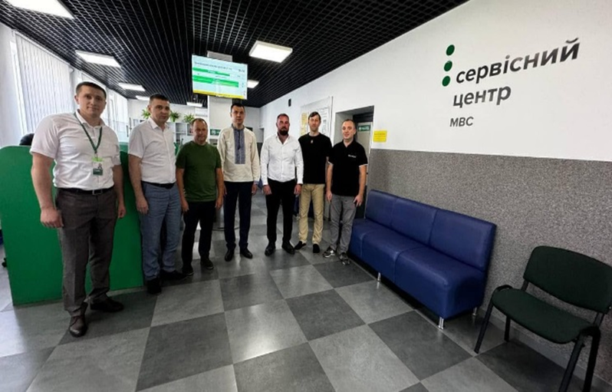
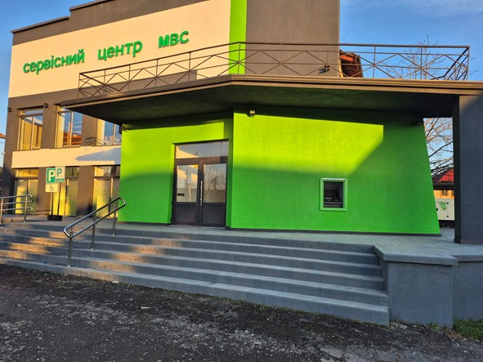
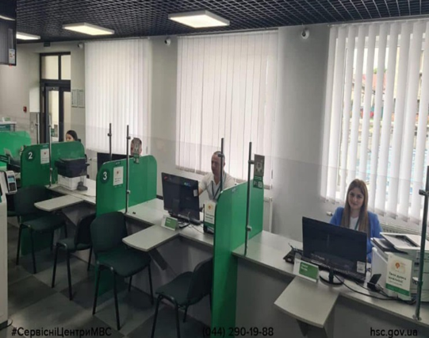
The most important initiatives of the last 3 years
Kamianska community
Transcarpathian region, Ukraine
Establishment of Service Center No. 2146
of the Ministry of Internal Affairs
  In June 2024, a branch of the Ministry of Internal Affairs Service Center No. 2146 began operations.
  At this center, you can quickly register a vehicle, exchange a driver’s license, obtain an international driver’s license, and order custom license plates.
  Since it opened, the center has contributed over 1,000,000 hryvnias to the local community budget.

Slide 10
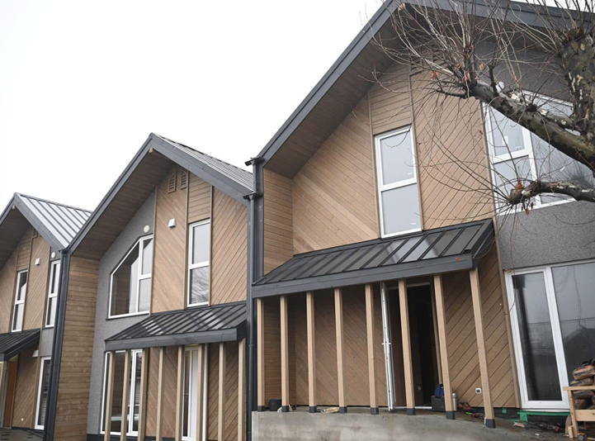

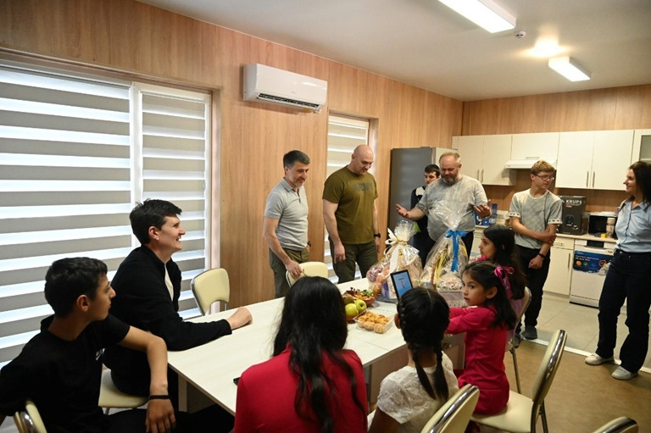
The most important initiatives of the last 3 years
Kamianska community
Transcarpathian region, Ukraine
Construction and furnishing of modular frame-panel houses for large families among internally displaced persons
  In 2025, alongside the “Shelter” project in the village of Ardanovo, with the support of the Transcarpathian Regional State Administration and the NGO “Person in Need,” construction and furnishing of modular frame-panel houses for large families among IDPs, which began in 2023, will continue under the First Lady’s “Address of Childhood” project.

Slide 11
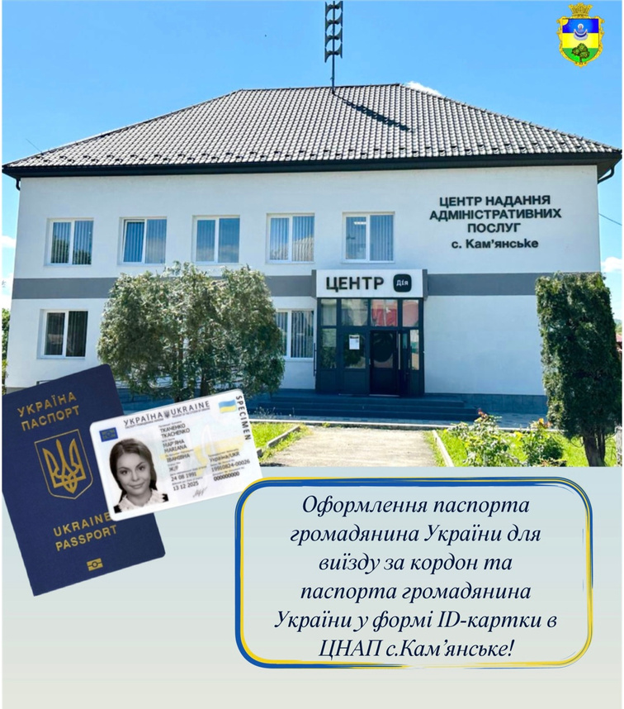
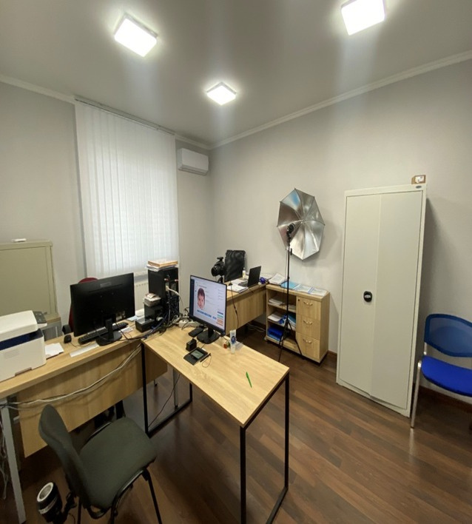
The most important initiatives of the last 3 years
Kamianska community
Transcarpathian region, Ukraine
Activities of the “Administrative Services Center” Department
  Every year, the number of services provided by the village council’s “One-Stop Service Center” increases. Thanks to the Center, which operates on the principles of a “one-stop shop” and “open space,” it is possible to access services provided by various government agencies and local government departments within a single facility - conveniently, quickly, and in one place - with comfortable waiting areas, document completion, payment for services, and consultations on any issues.

Slide 12
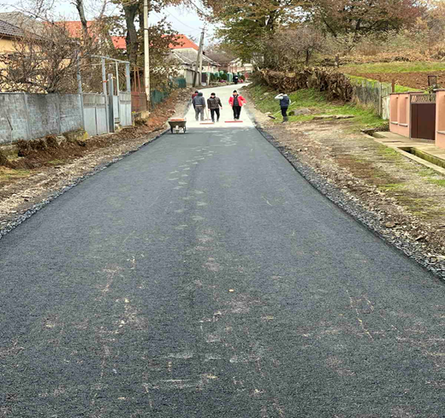
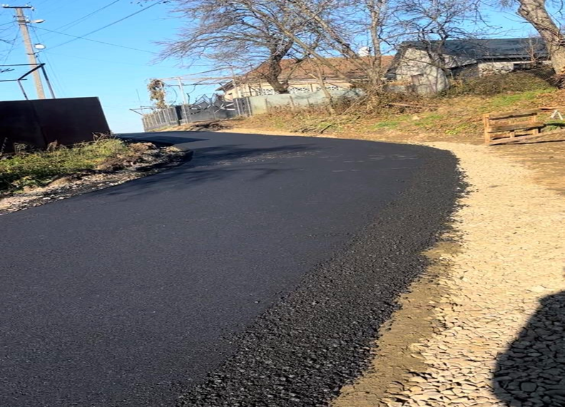
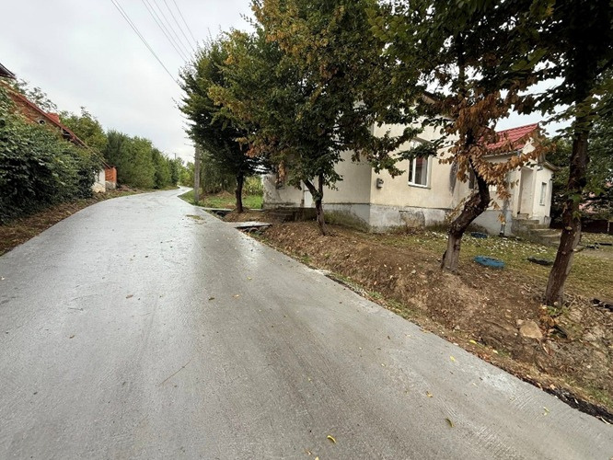
The most important initiatives of the last 3 years
Kamianska community
Transcarpathian region, Ukraine
Major road repairs in the community

Slide 13
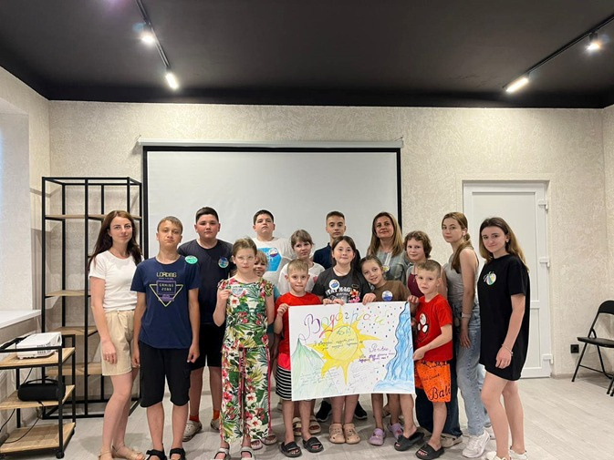
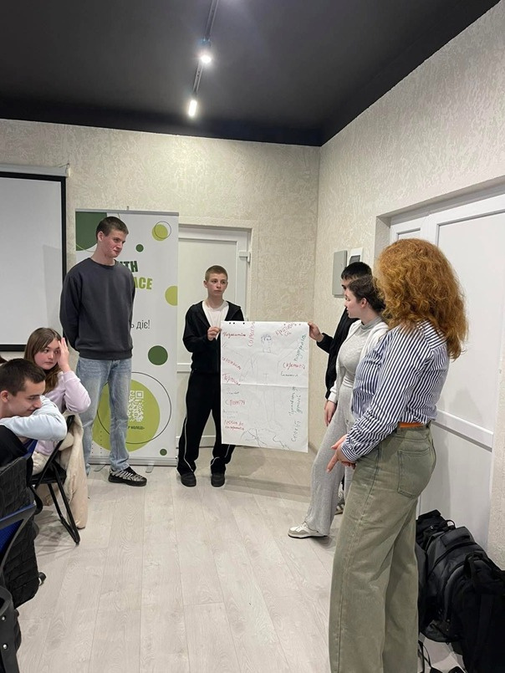
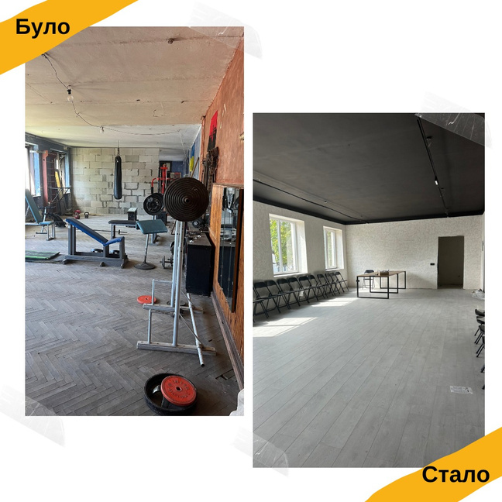
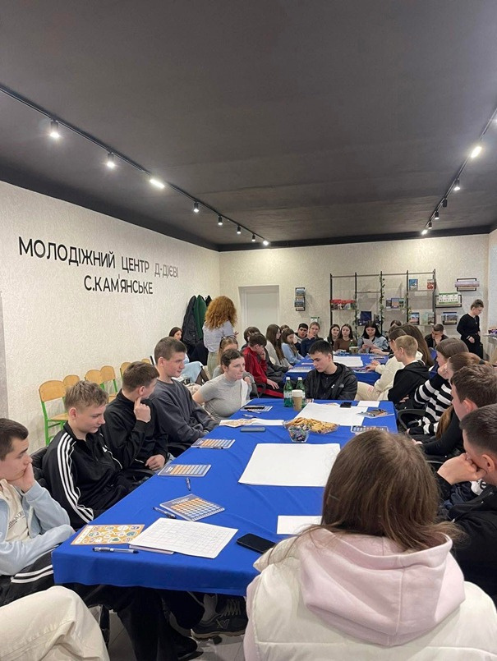
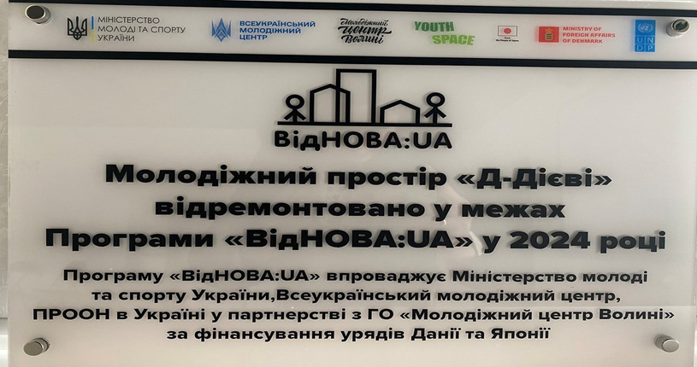
The most important initiatives of the last 3 years
Kamianska community
Transcarpathian region, Ukraine
Establishment of the “D-Diyevi” Youth Center in the village of Kamianske
  Our community hosted the “VidNOVA:UA” program, which aims to engage young people in Ukraine’s recovery through youth exchanges.
  As a result, an 82-square-meter space was renovated and equipped, creating an environment where young people can come together.
  The program is implemented by the Ministry of Youth and Sports of Ukraine, the All-Ukrainian Youth Center, and UNDP in Ukraine in partnership with the NGO “Volyn Youth Center,” with funding from the governments of Denmark and Japan.

Slide 14
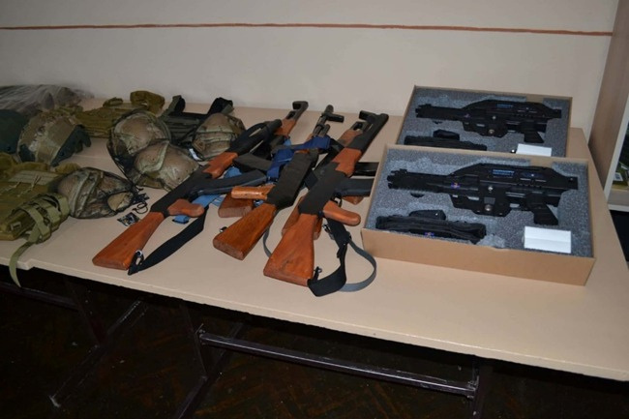
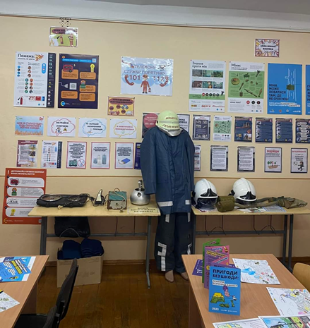
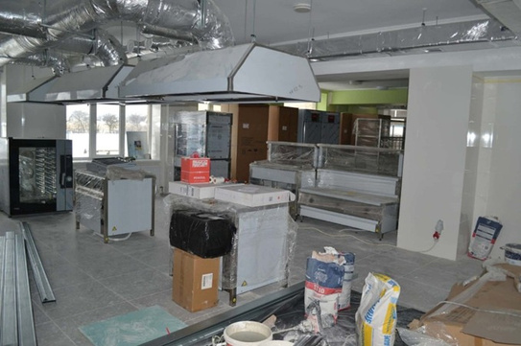
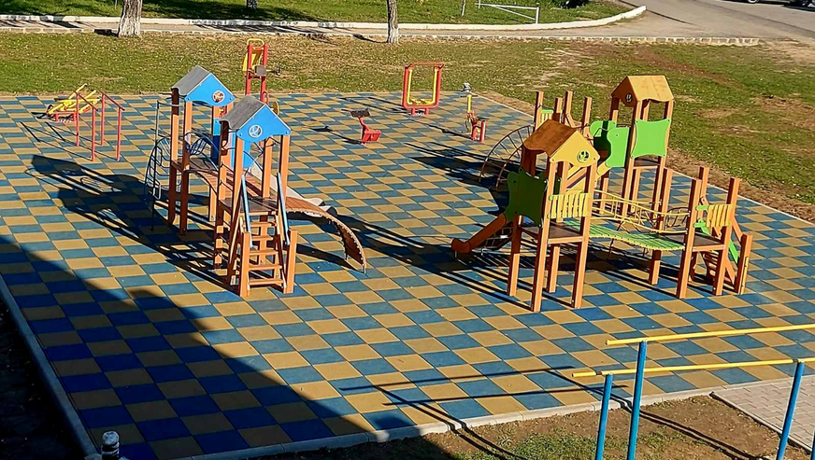
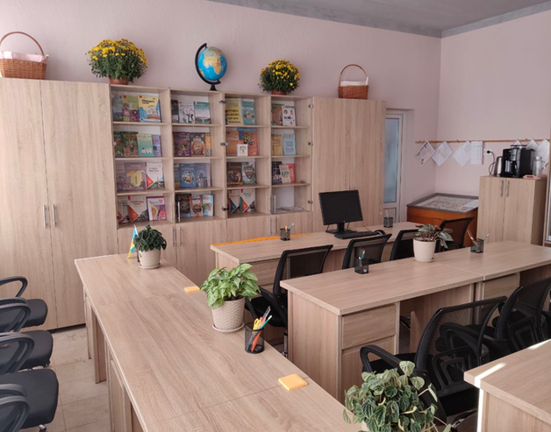
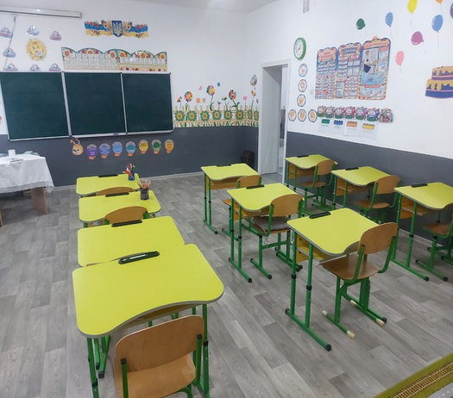
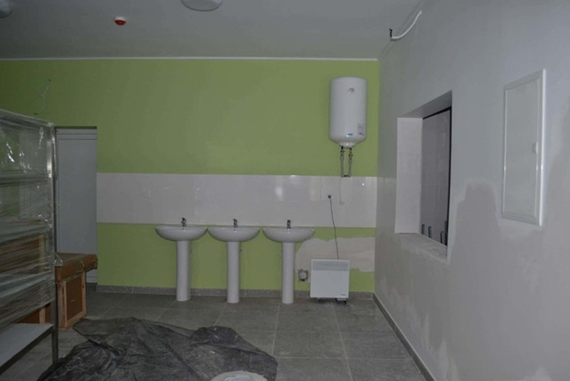
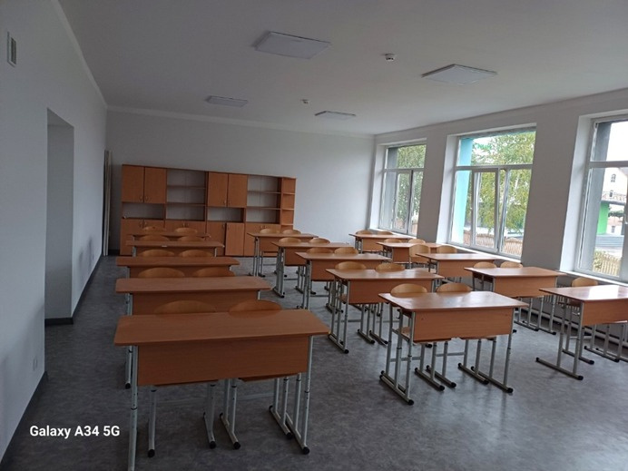
The most important initiatives of the last 3 years
Kamianska community
Transcarpathian region, Ukraine
Carrying out repair work and improving the material and technical infrastructure of schools in the community

Slide 15
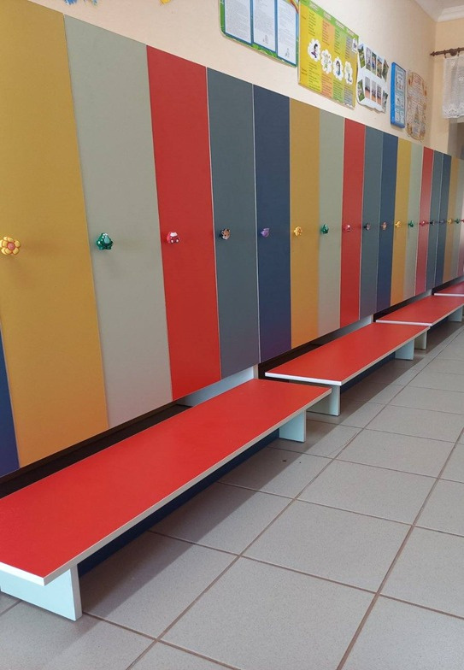
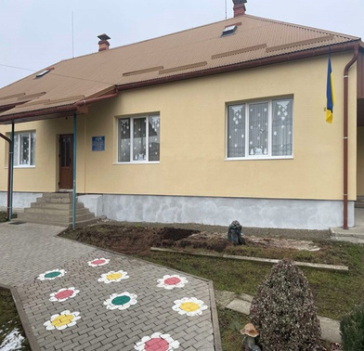
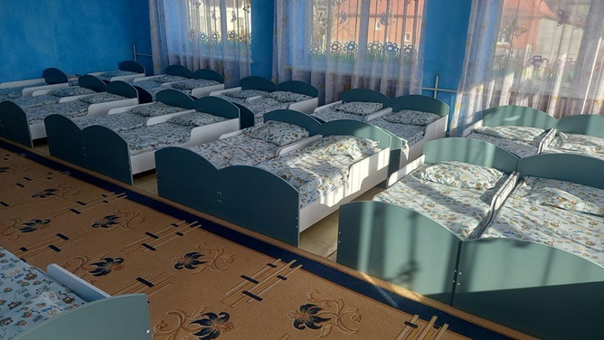
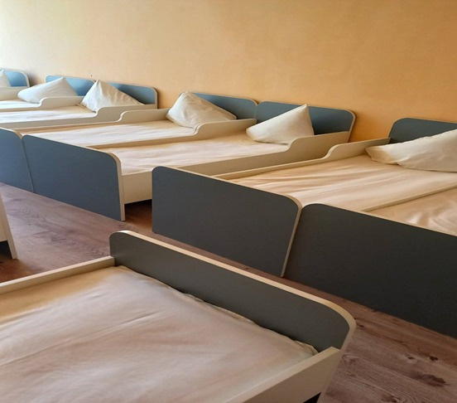
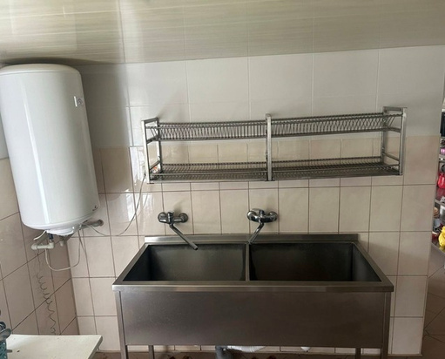
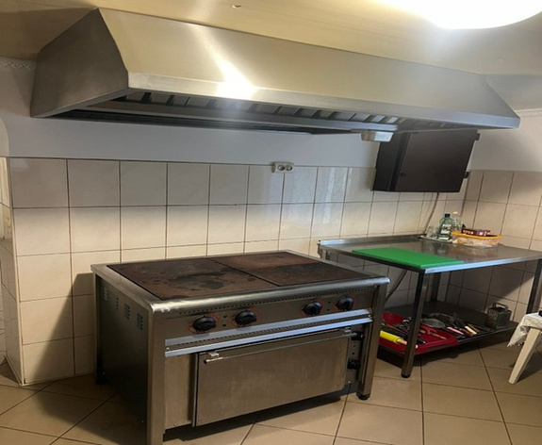

The most important initiatives of the last 3 years
Kamianska community
Transcarpathian region, Ukraine
Carrying out repair work and improving the material and technical infrastructure of the community’s preschool education facilities

Slide 16



The most important initiatives of the last 3 years
Kamianska community
Transcarpathian region, Ukraine
Mobile Social and Psychological Support Team
  In 2024, a grant of 1.5 million hryvnias was received from the state budget to the local budget. These funds were used to purchase a specialized vehicle for a mobile social and psychological assistance team serving individuals who have suffered from domestic violence and/or gender-based violence.

Slide 17





Areas of cooperation
Kamianska community
Transcarpathian region, Ukraine
  Community Safety (establishment of a safety center to ensure comprehensive safety for community residents)
Energy (installation of solar power plants)
  Mining and Processing of Minerals

Slide 18



Why should
  an investor choose our community?
Kamianska community
Transcarpathian region, Ukraine
Our community has significant natural and economic potential - deposits of construction materials, agricultural resources, water bodies, and favorable conditions for the development of tourism and entrepreneurship. This provides a solid foundation for implementing international projects and investment initiatives.
Our community’s strategic location in a border region and our openness to cooperation with foreign communities create opportunities for cross-border partnerships, the exchange of expertise, and the implementation of joint grant programs, which contribute to the development of the local economy and the improvement of residents’ quality of life.
Our community is home to many active, enterprising individuals, community leaders, and entrepreneurs. Residents actively participate in community initiatives, educational programs, and projects, which strengthens the community’s capacity to implement international grants and partnership projects.

Slide 19



Resources
for a joint project
Kamianska community
Transcarpathian region, Ukraine
Buildings
Land plots
Team and Experience
The community is ready to grant the partner access to resources and enter into long-term agreements

Slide 20









Kamianska community
Transcarpathian region, Ukraine
Idea for implementation
CITIZEN SAFETY CENTER
  There is a vacant plot of municipally owned land within the community where a logistics center is planned to be built.
  The main functions of the logistics center will include cargo handling and storage, customs clearance, and information services.
  The transport and logistics center will provide space for freight forwarding and transport companies and will have a parking lot for trucks.
  The logistics center’s advanced system will help shorten supply chains, optimize the flow of goods, and increase the flexibility of deliveries.
  The logistics center is being created to solve the problem of delivering goods from the supplier to the consumer in the shortest possible time and at the lowest possible cost, and to bring together businesses engaged in international freight transport, of which there are about 20 in the community.

Slide 21



Kamianska community
Idea for implementation
Transcarpathian region, Ukraine
CITIZEN SAFETY CENTER
  Improving community safety by establishing a Safety Center to meet residents’ needs for comprehensive safety services, including civil protection, public order, and medical care.
  The reconstruction and expansion project will enable the creation of a Security Center within the Kamyanska Territorial Community, which will house a fire and rescue unit, an ambulance unit, and a police station.
  A land plot is available on which the Security Center can be located.
  The Security Center’s location is optimal, as it will be equidistant from the rest of the community’s villages, ensuring access to services for all community residents and reducing transportation costs.
  The Security Center is designed to meet the needs of the community’s population (9,447 people, including 214 IDPs) as well as residents of neighboring communities (25,000 people).

Slide 22




The support
the community needs
Kamianska community
Transcarpathian region, Ukraine
Expert
Investment
04
Technical

Slide 23








CONTACTS
Mykhailo Stanynets
Head of the Kamianska community
+380503722959
kamrada1@ukr.net
kam-rada.gov.ua/
90125, Kamianske,
1 Ukrainska St.,
Berehove District, Zakarpattia region
Developed within the framework of the project «Eurocommunity: financial opportunities for development and European integration», which is implemented by the Carpathian agency of human rights Vested together with the Faculty of Law of Uzhhorod National University with the support of the European Union and the International Renaissance Foundation within the framework «Whole-of-Society Accession» project. Its content is the exclusive responsibility of the authors and does not necessarily reflect the views of the European Union and the International Renaissance Foundation.

